Slide 1
TECHTRONIX INNOVATIONS “BUSINESS TURNAROUND”

Slide 2
CONTENT
CUSTOMER SEGMENT ANALYSIS
SALES PERFORMANCE ANALYSIS
PRODUCT MARKET PERFORMANCE

Slide 3
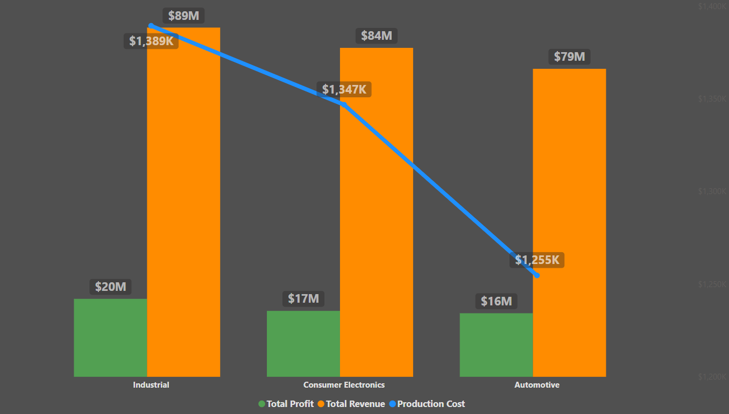
CUSTOMER SEGMENT ANALYSIS

Slide 4
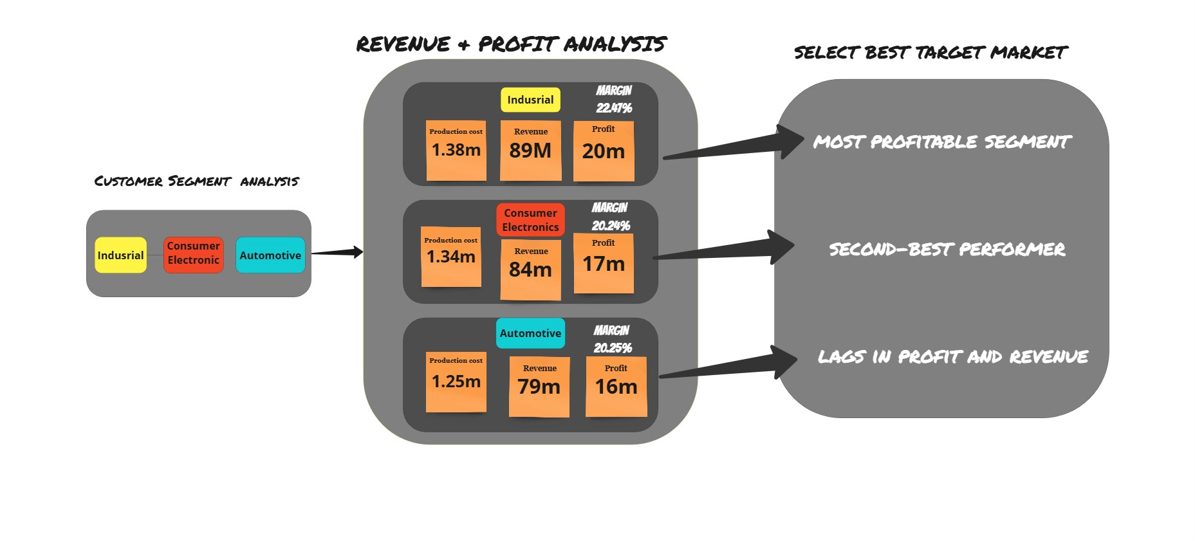
CUSTOMER SEGMENT ANALYSIS

Slide 5
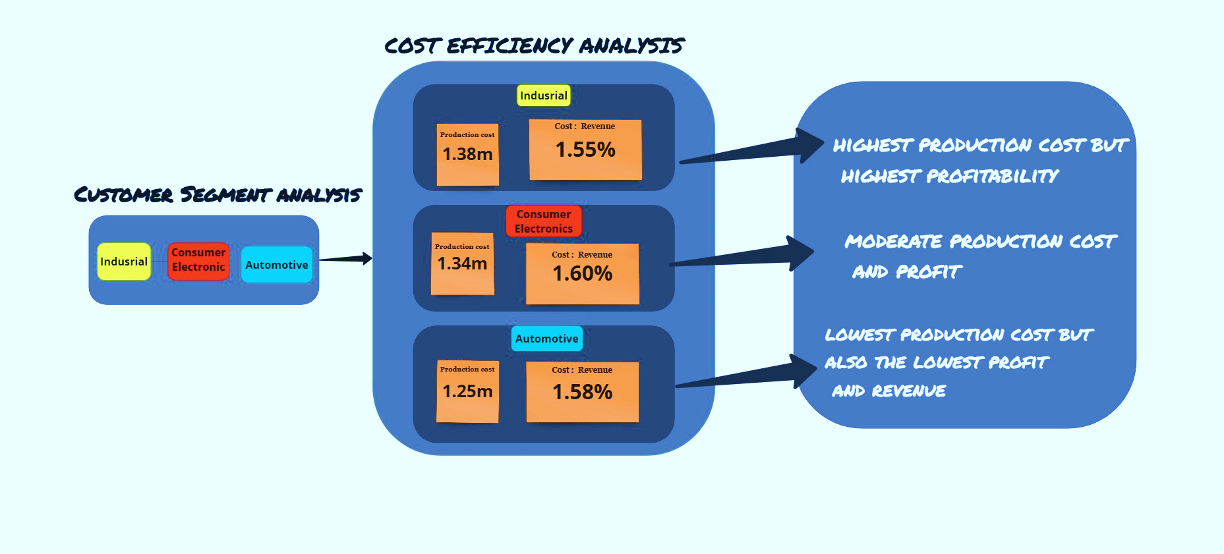
CUSTOMER SEGMENT ANALYSIS

Slide 6

INSIGHTS
Industrial segment = most efficient at converting production costs into
revenue and profit.
Automotive and Consumer Electronics have similar cost efficiencies but lower profit
generation.

Slide 7
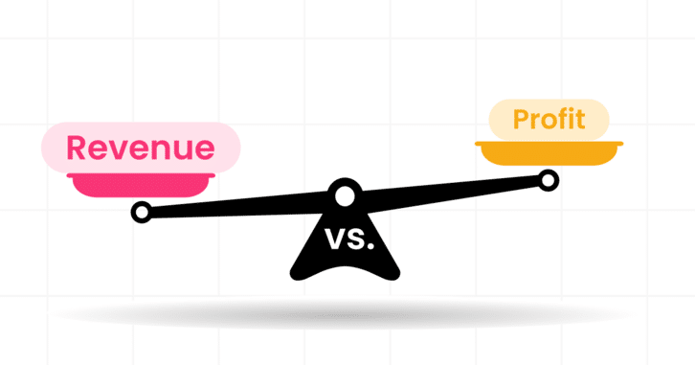
Profitability vs. Revenue Potential
Industrial outperforms in profit and efficiency, showing robust
profitability.
Consumer Electronics generates a competitive profit margin,
suggesting a strong market position despite slightly higher costs.
Automotive has room for improvement in revenue generation and
maximisation.

Slide 8
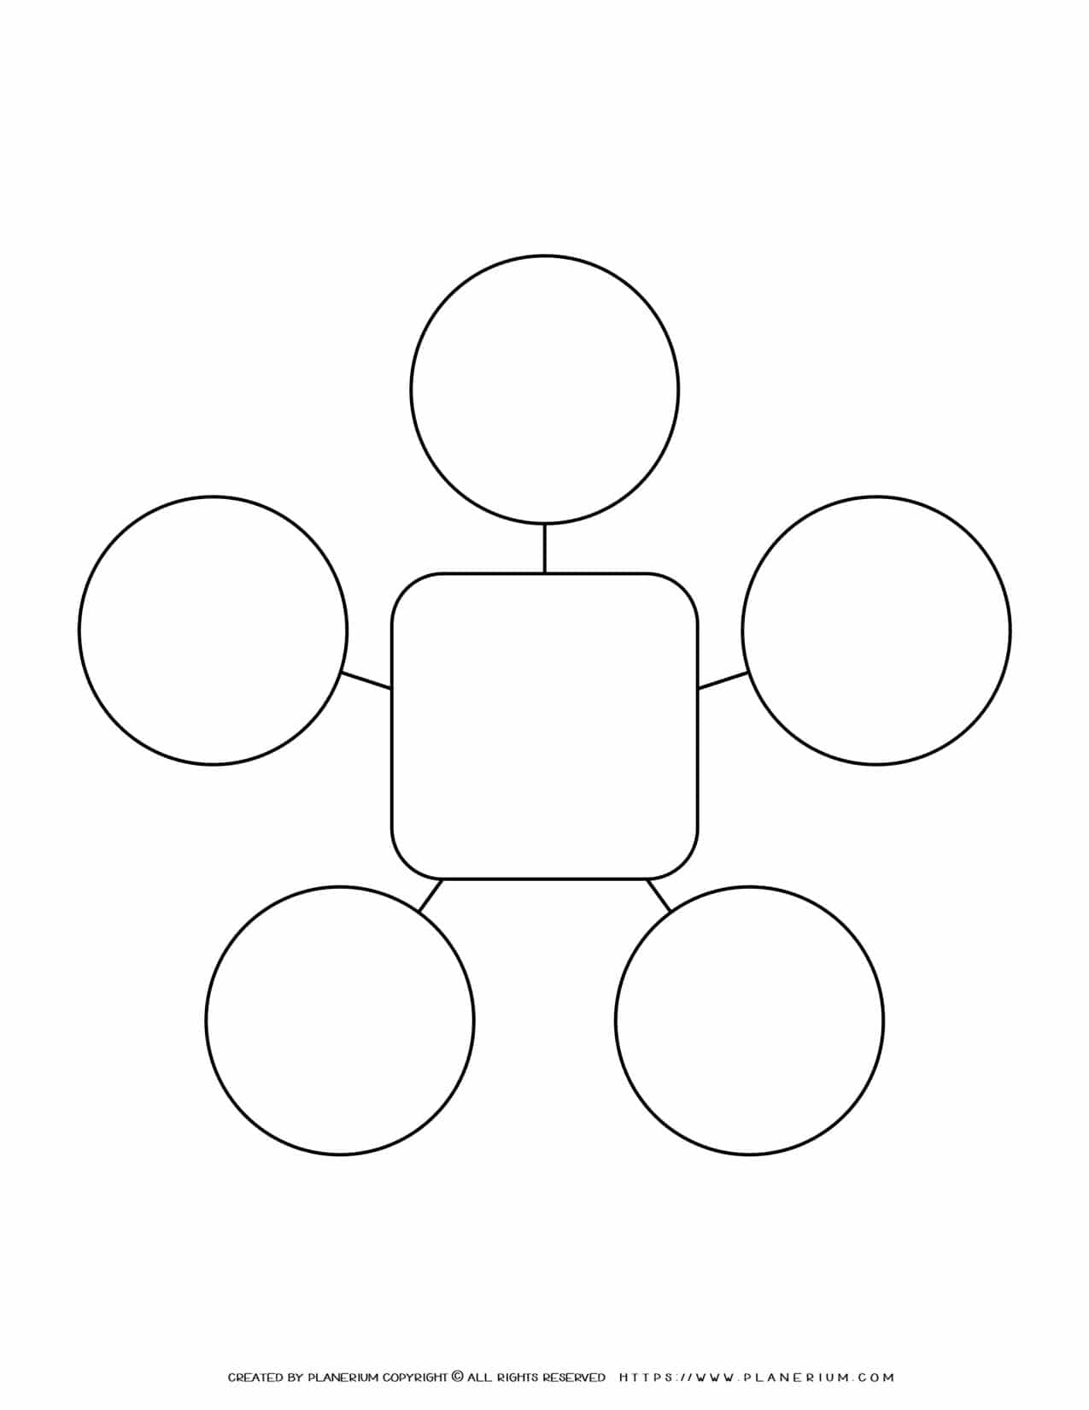
recommendations
Focus
on Expanding
the Industrial
Segment
Prioritising
Industrial segment
while strategically
Enhancing Consumer Electronics and reviving Automotive, would drive
growth and profitability
more effectively
Optimise the
Consumer
Electronics
Segment
Customer Segment
Recommendations
Segment-Specific
Marketing and
R&D
Revitalise the
Automotive
Segment

Slide 9
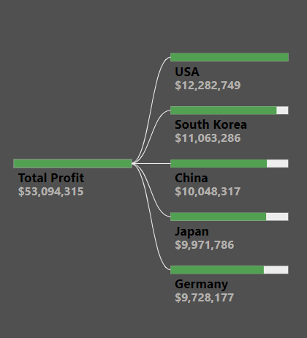
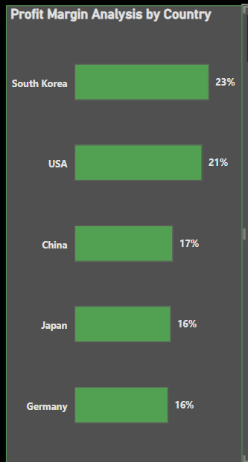

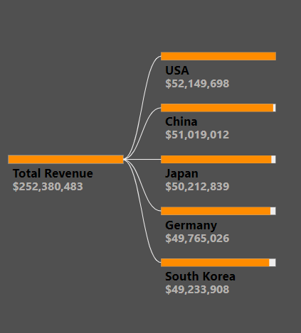




Sales Performance Analysis

Slide 10
INSIGHTS
The company's revenue is well-distributed, with no country dominating more than 21% of the total revenue. This reduces over-reliance on a single market.
The USA is the top revenue contributor, generating 20.67% of total revenue.
South Korea has the highest profit margin (23%) despite being the lowest revenue generator, suggesting strong cost efficiency or premium product pricing.

Slide 11
recommendations
Focus on High-Profit Markets. USA & S/Korea
Optimise Cost Structures in China, Japan, and Germany
Monitor Currency and Economic Conditions
Sales Performance
Recommendations
Regional Marketing and Product Customisation
Explore Growth in the least performing Region. Germany

Slide 12
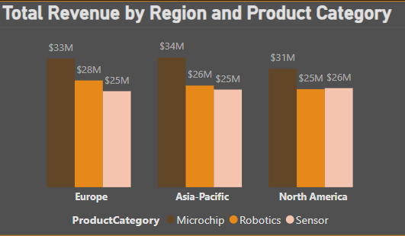
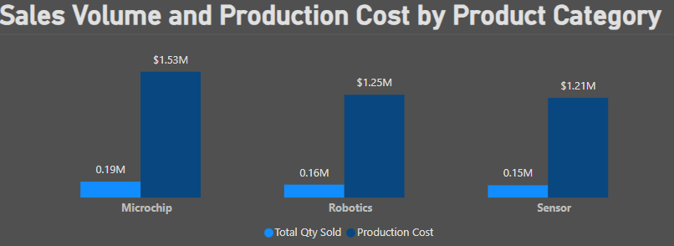
Sales Performance Analysis

Slide 13

Sales Performance Analysis
Revenue across all regions and categories is relatively balanced, with Microchip leading in all.
The company demonstrates balanced performance across regions and categories, with Microchip leading in revenue and Robotics excelling in cost efficiency.
Prioritise investment in Microchip, given its dominant revenue share and strong demand.

Slide 14
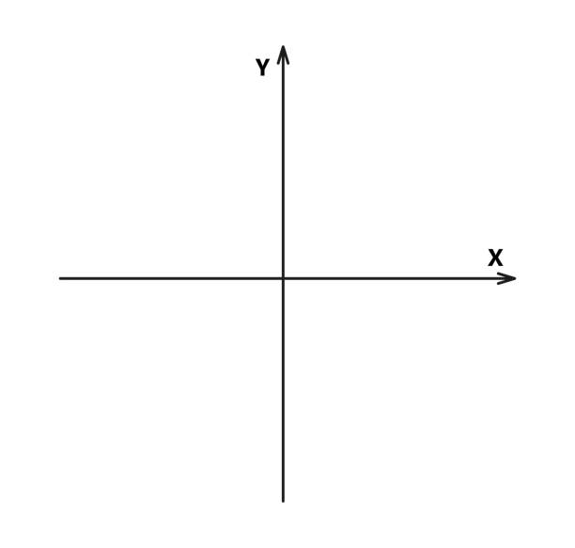
Product Market Performance (Using BCG Matrix - Boston Consulting Group)
The BCG Matrix divides products into four quadrants:
Stars, high-growth leaders needing investment to maintain dominance;
Cash Cows, mature, profitable products generating steady cash flow;
Question Marks, high-growth but low-market-share products with the potential to become Stars or Dogs; and
Dogs, low-growth, low-share products are often best divested. It’s a snapshot of where to invest, nurture, or cut for strategic success.
Cash Cows
Stars
Dogs
Question Marks

Slide 15
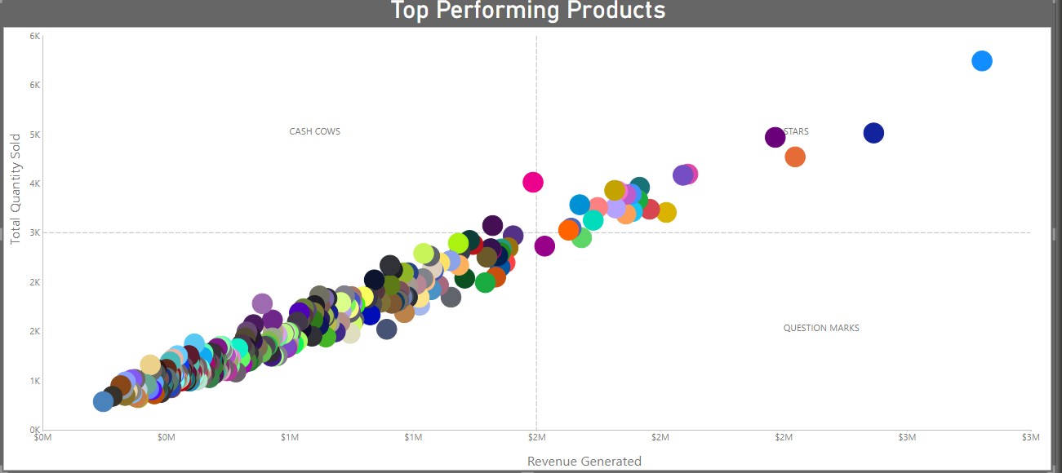
Product Market Performance

Slide 16
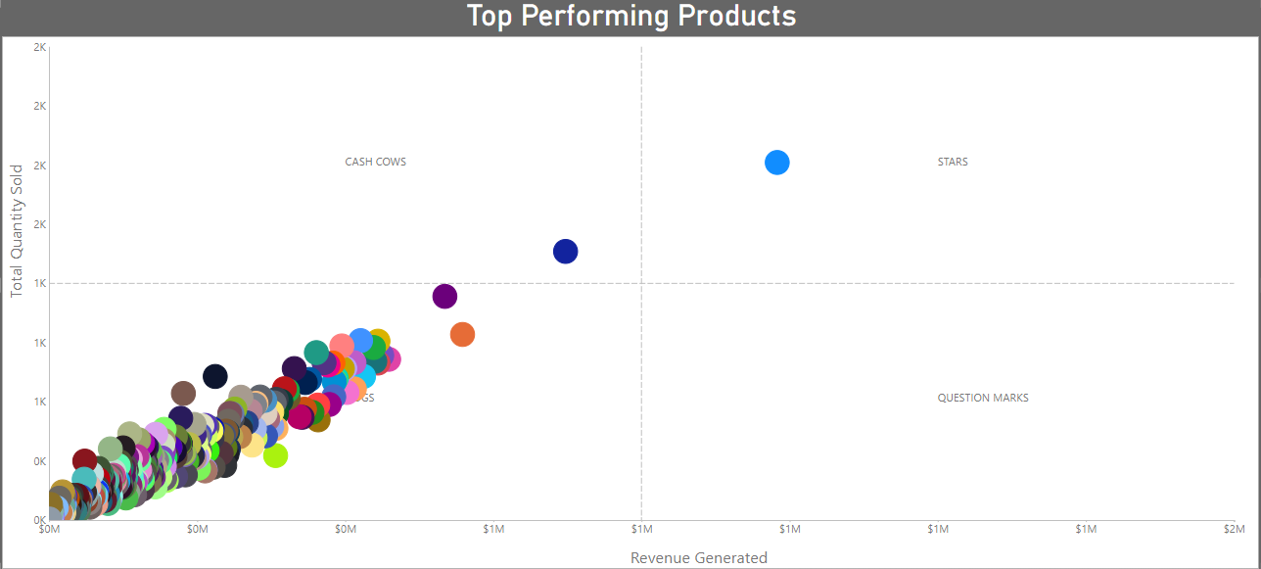
Product Market Performance

Slide 17
recommendations
Product Market Performance
Optimise Cash Cows
Focus on Stars
Cull or Redefine Dogs
Revive Question Marks

